Slide 1
CPU
CPU Good at serial instruction processing; instructions that must be computed in sequence

Slide 2
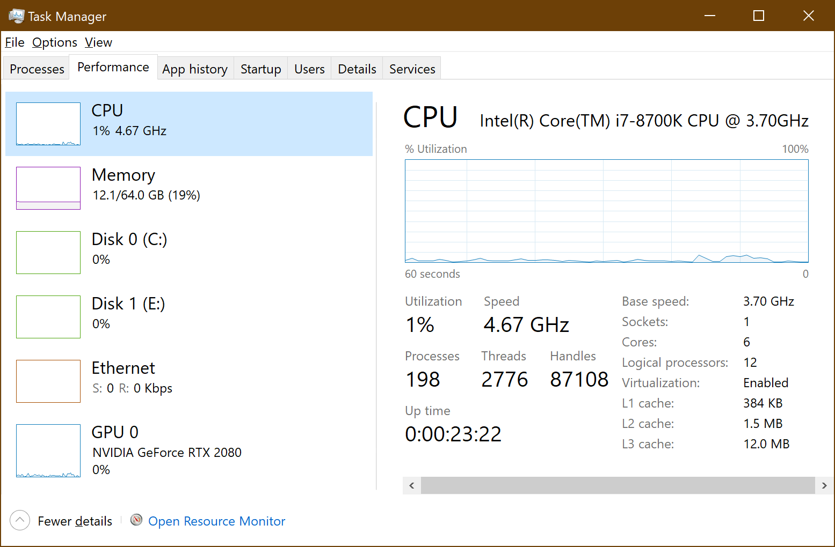
CPU Laymen Overview
Windows Task Manager:
Clock Speed
4.67 GHz
6 Cores
Relates to Hyperthreading; Different Discussion

Slide 3
Parallel Processing
Remember PEDMAS?
1
2
3
4
5
6

Slide 4
GPU
Don’t have to be expensive

Slide 5
Recurrent Neural Network

Slide 6
Setting up Environment
Re-useable guide
Be careful with Nvidia driver updates; they do it often and do not auto install

